Slide 1
Object Oriented Programming Lecture - 25
Prof. Varsha Dange

Slide 2
interface
An interface is a fully abstract class.
It includes a group of abstract methods (methods without a body).
There can be only abstract methods in the Java interface, not method body.
From Java 8, interface can have default and static methods too.

Slide 3
Contd...
It is used to achieve abstraction and multiple inheritance in Java.
Java Interface also represents the IS-A relationship.
It cannot be instantiated just like the abstract class.
To use an interface, other classes must implement it.
use the implements keyword to implement an interface.

Slide 4
Why use Java interface?
There are mainly three reasons to use interface. They are given below.
It is used to achieve abstraction.
By interface, we can support the functionality of multiple inheritance.

Slide 5
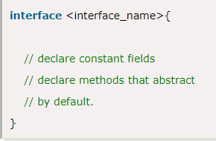
Syntax

Slide 6
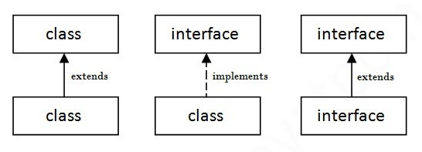
The relationship between classes and interfaces
As shown in the figure given below, a class extends another class, an interface extends another interface, but a class implements an interface.

Slide 7
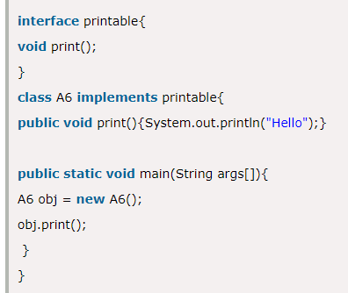

Example

Slide 8
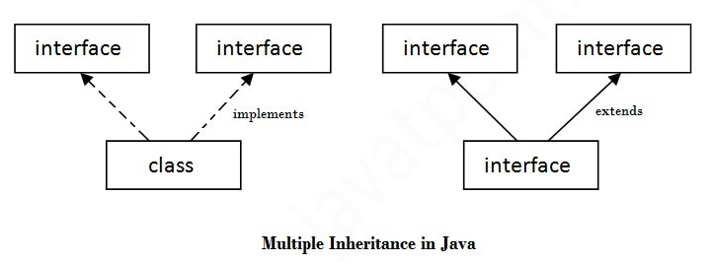
Multiple inheritance in Java by interface
If a class implements multiple interfaces, or an interface extends multiple interfaces, it is known as multiple inheritance.

Slide 9
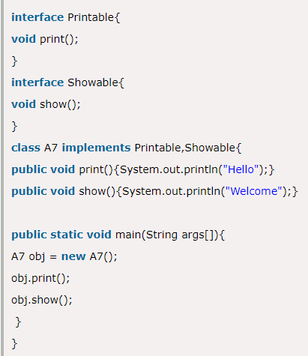

Contd…

Slide 10
Multiple inheritance is not supported through class in java, but it is possible by an interface, why?
multiple inheritance is not supported in the case of class because of ambiguity.
it is supported in case of an interface because there is no ambiguity.
It is because its implementation is provided by the implementation class.

Slide 11
Interface inheritance
A class implements an interface, but one interface extends another interface.

Slide 12
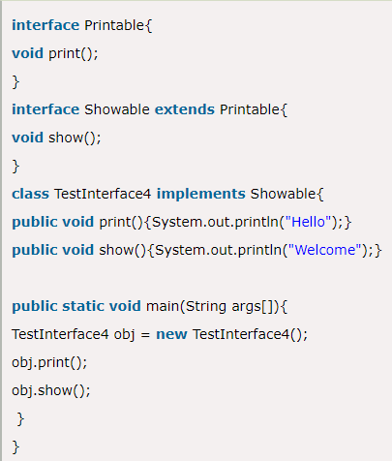

Contd…

Slide 13
Difference between abstract class and interface
Abstract class and interface both are used to achieve abstraction where we can declare the abstract methods.
Abstract class and interface both can't be instantiated.
there are many differences between abstract class and interface that are given below.

Slide 14
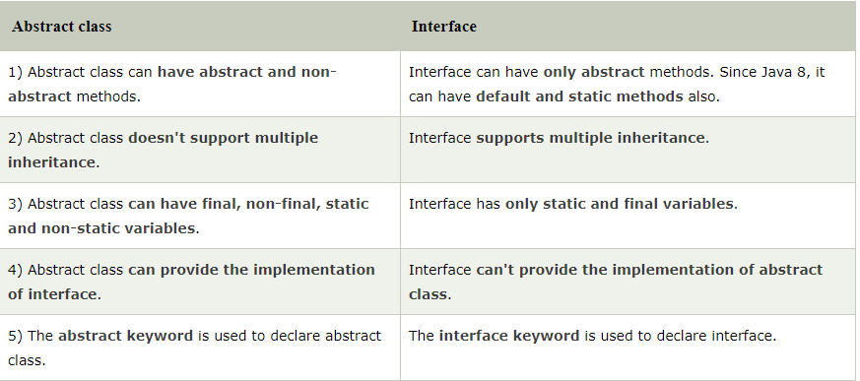
Contd..

Slide 15
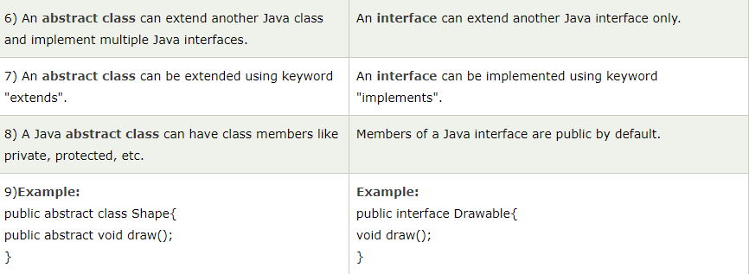
Contd…

Slide 16
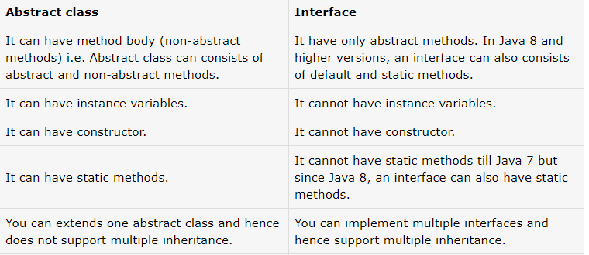
Contd..

Slide 17
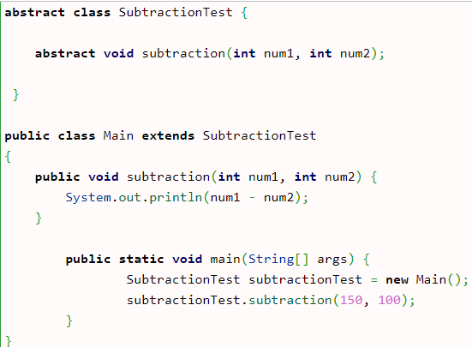
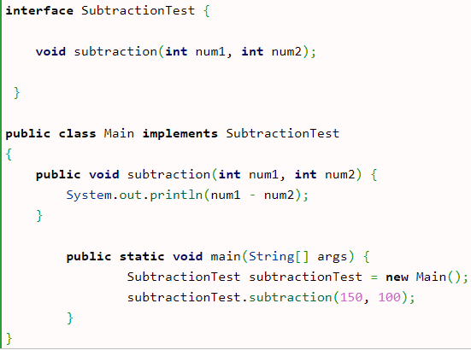

Contd..

Slide 18
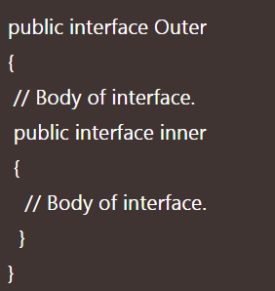
Nested Interface in Java
When an interface as a static member is declared inside a class or another interface, it is called nested interface in java.
Nested interface must be declared as public inside another interface.
The nested interface can be declared in the following general form.

Slide 19

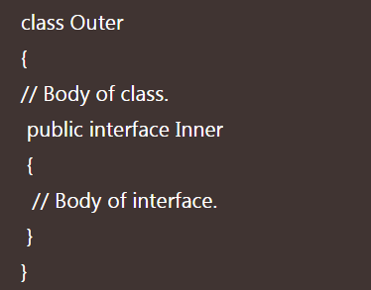
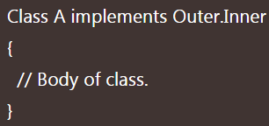
Nested Interface in Java
Now a class can implement nested interface Inner by using the following below statement.
Interface inside Class:
The general syntax to define an interface inside a class in java is as follows:

Slide 20
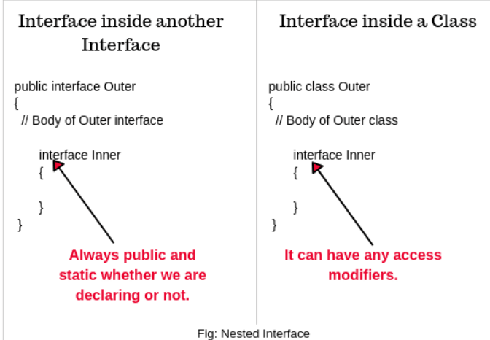
Nested Interface in Java
Every inner interface or class is always implicitly public and static whether we are declaring or not.
If you declare inner interface inside a class then it can have any access modifiers.

